Slide 1
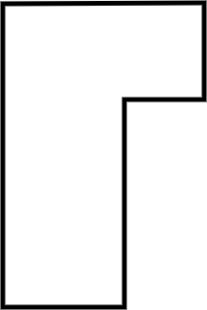
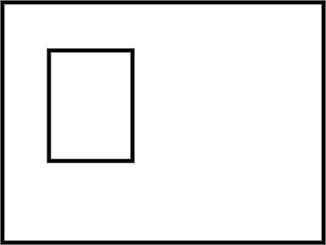
Calculating missing side lengths from the area of composite rectilinear shapes
Task A: Calculating area with missing side lengths
1) Calculate the area of each composite rectilinear shape.
a) b)
16 m
12 m
3 m
17 m
2 m
11 m
4 m
5 m
5 m
19 m
Task B: Finding a missing side length using area
1) Calculate the length of the marked side.
a) b)
23 cm
18 cm
13 cm
4 cm
2 cm
7 cm
h
Area = 309 cm²
t
Area = 187 cm²

Slide 2
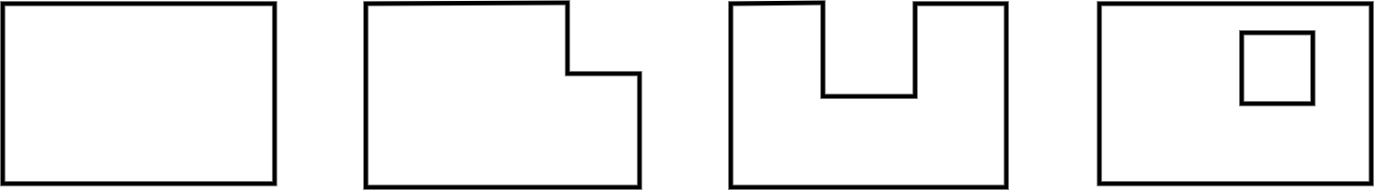
Calculating missing side lengths from the area of composite rectilinear shapes
Task C: Working with perimeter and area
1) Which shapes have the same area? Which have the same perimeter?
a) b) c) d)
3 mm
3 mm
3 mm
8 mm
3 mm
3 mm
3 mm
8 mm
8 mm
8 mm
10 mm
10 mm
10 mm
10 mm
Mathematics in Education and Industry.

